Slide 1
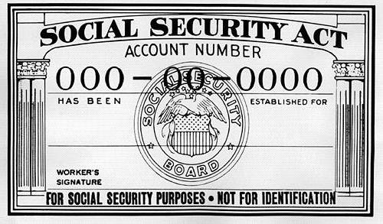
Social Security & RR Retirement Tier 1
Pub 17, Chapter 11
Pub 4012 Tab D
(Federal 1040-line 20)
Notes:
1

Slide 2
Printing of Social Security Documents
SSA discontinued providing SS number printouts effective 8/1/2014
Taxpayers who do not have their SS cards will need to complete application for a SS card (Form SS-5) and provide required documentation
SSA stopped providing benefit verification letters in their offices on 10/1/2014
Taxpayers can get instant letter online or may call SSA to request a letter by mail
Notes:
2

Slide 3
Tax On Social Security & RR Retirement Tier 1
Social Security (SS) and RR Benefits Tier 1 have same tax treatment
May be non-taxable or partially taxable, depending on total income from other sources
Up to 85% of benefits may be taxable
May be taxable if one-half of SS plus all other income (including tax-exempt interest) is greater than:
$32,000 MFJ
$25,000 single, HOH or qualified widow
$25,000 MFS & lived apart all year
$0 MFS & lived together any part of year
TaxWise calculates how much of SS is taxable on Federal Return
Social Security and RR Tier 1 is not taxable in NJ
Note: There is no line item for this on NJ 1040
Notes:
3

Slide 4
Social Security & RR Retirement Tier 1
End-of-year statements
Social Security - SSA-1099 (disability or retirement)
Railroad Retirement Tier 1 - RRB-1099 (Blue Form)
Where to report?
From Federal1040 Line 20a, go to 1040 Wkt 1
Enter data in section “SS & RR Tier 1” benefits as per SSA-1099 or RRB-1099
Include Medicare Parts B (Hospital Insurance), C (Medicare Advantage), & D (Prescription Drug coverage) on 1040 Wkt 1
TW transfers to Sch A Detail Worksheet
Notes:
4

Slide 5
Sample SSA-1099 Form
Enter on 1040 Wkt 1
Notes:
This is a sample SSA-1099 form showing how Social Security income & Medicare expenses are reported
When filling out Wkt 1, be sure to use the pink box (Box 5) not Box 3
The forms are sent out by Jan 31. Lost or missing copies can be obtained online or requested by phone (takes 10 days)
5

Slide 6
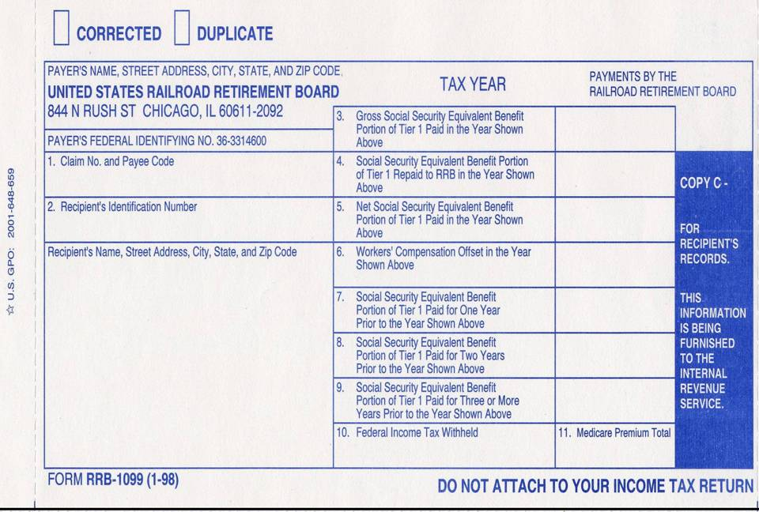
Railroad Retirement Benefits Equivalent to Social Security
$15,972
Douglas Davis
210 Main Street
Bridgewater, NJ 08807
Enter on 1040-Wkt 1
$1,607
Notes:
Sample Railroad Retirement Benefits RRB-1099 showing how Railroad Retirement Tier 1 income & Medicare expenses are reported
6

Slide 7
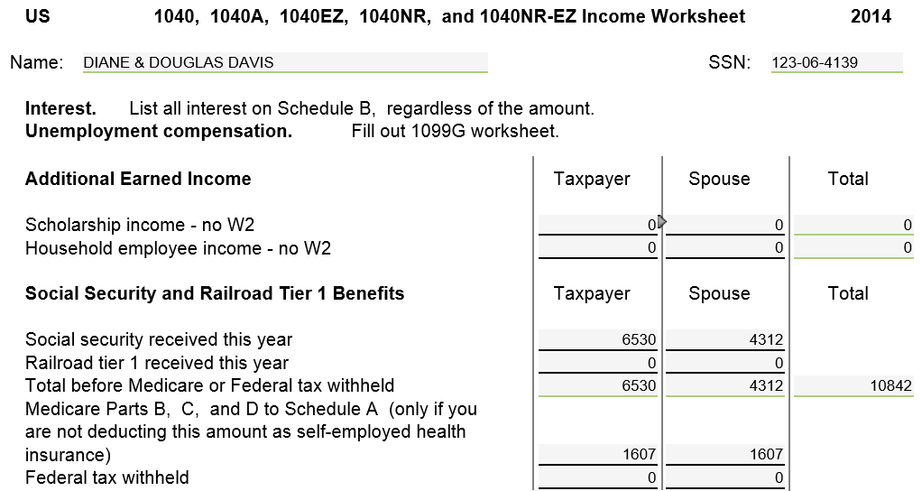
TW Social Security/ RR Benefits – 1040 Wkt 1
Net benefits from SSA-1099 Box 5
Use scratch pad if more than 1
Medicare plan
Notes:
Pull up 1040 Wkt 1 screen
Link from Line 20a on 1040 Page 1 (using arrow or F9) OR
Go directly to Worksheet by clicking on 1040 Wkt1 in Forms Tree
Scroll to Social Security & Railroad Tier 1 section
Enter Social Security/Railroad Tier 1 received this year from SSA-1099 or RRB-1099 Box 5
Enter Federal Tax Withheld from SSA-1099 Box 6 or RRB-1099 Box 10
Enter total of Medicare deductions (including Parts B, C, & D) from SSA-1099 Description box or RRB-1099 Box 11
If only one type of Medicare premiums, enter directly on Medicare line. If multiple types of Medicare premiums, enter on scratch pad off Medicare line and let TW add
TW will transfer this amount to Sch A Detail screen for itemized deductions under Medical Expenses
7

Slide 8
TW Social Security Income on Federal 1040 Line 20
TW transfers from 1040
Wkt 1
TW calculates
Notes:
TW transfers Social Security income from 1040 Wkt 1 to 1040 Line 20a
TW automatically calculates how much of Social Security is taxable, based on total of taxpayer’s other income & populates on 1040 Line 20b
8

Slide 9
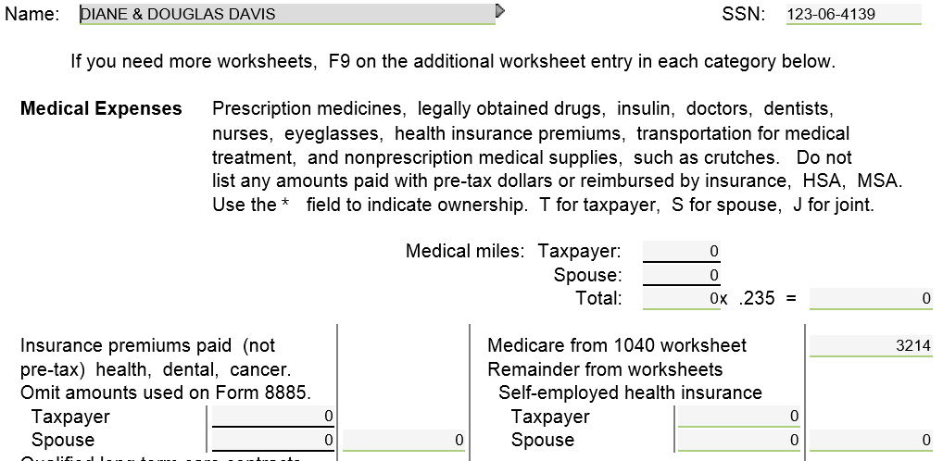
Medicare Expenses on Schedule A Detail
TW transfers from 1040
Wkt 1
Notes:
TW transfers Medicare Parts B, C, & D expenses from 1040 Wkt 1 to Schedule A Detail
9

Slide 10
Tips For Entering Into TW
Enter amount from Box 5 of SSA-1099 or RRB-1099 into TW 1040 Wkt 1 Amount Received this Year
Don’t forget to look for Federal Withholding
Always enter Medicare Parts B, C, & D even if the taxpayer isn’t planning on itemizing – may qualify for NJ lower medical threshold
Use a scratch pad to document the separate amounts
Notes:
10

Slide 11
Social Security on NJ 1040
Social Security is not taxable for NJ so SS income does not flow through to NJ return
Medicare premiums entered on 1040 Wkt 1 will flow through to medical expenses on NJ 1040 line 30 (if medical expenses exceed 2% of NJ gross income on line 28)
Therefore, NJ taxable income can change when you enter Social Security. Even though there is no new income on NJ return, the deduction can increase
Notes:
11

Slide 12
Lump Sum Social Security or RR Retirement Payments for Prior Years
Taxpayers may have received lump sum SS or RR retirement benefits, including benefits from prior year(s)
Shown on SSA-1099A or RRB-1099, Box 3
Can pay the lower of:
Tax on total sum based on current year’s figures
Tax on additional taxable amount of SS based on prior years’ figures (lump sum election)
Must have copies of prior years’ returns to calculate this
Notes:
Sometimes it takes a long time for taxpayers to be approved for SS benefits (especially disability). Thus, once they are approved, they may receive back payments for prior year benefits as well as the current year benefit
Lump sum amount is shown in SSA-1099A Box 3 & a breakdown by year is given in Description box
Taxpayer can choose to pay 1 of 2 amounts, whichever is lower:
Tax on total lump sum payment based on current tax year figures
Tax on additional taxable amount of SS based on prior years’ figures (lump sum election)
Must have copies of prior years’ returns to use this method
12

Slide 13
Special Topic for Lump Sum Payments
See TaxPrep4Free.org Special Topics document “Lump Sum Social Security Benefits” on Preparer page for instructions on how to handle SS/RRB lump sum payments

Slide 14
Foreign Old Age Payments for U.S. Residents
Old age payments from Canada & Germany
By treaty are added to/treated as Social Security (Pub 915)
Include on line 1 of 1040 Wkt 1
Taxpayer must have converted amount into US dollars (bank statement shows)
Old age payments from United Kingdom are treated as Pension income
Social Security payments from Norway are excluded and not taxable in U.S.
Notes:
14

